Slide 1
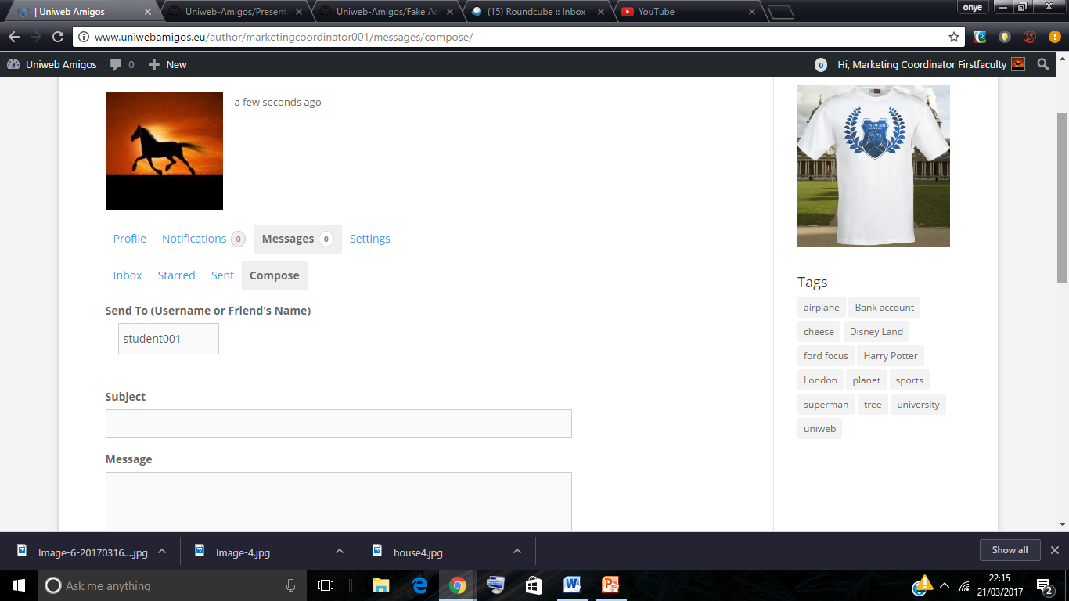
Private messages

Slide 2
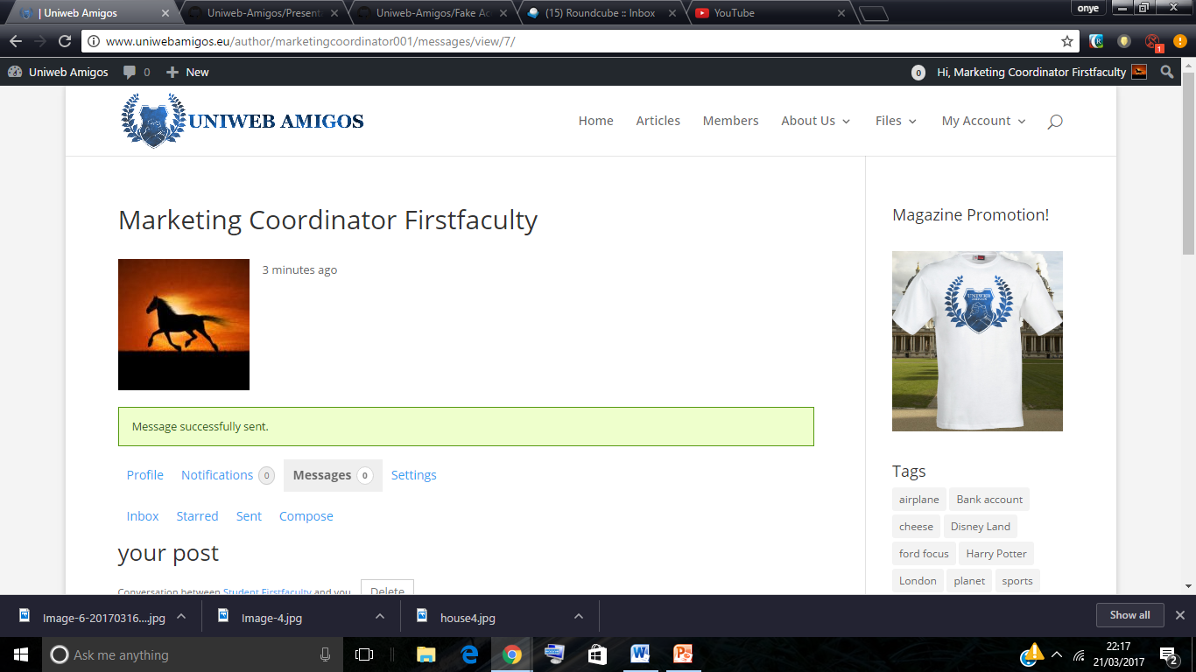
Message was sent successfully.

Slide 3
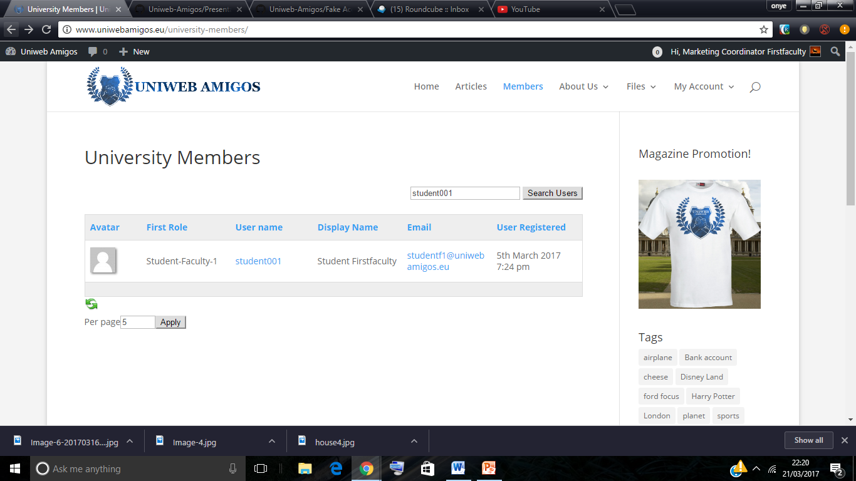
Searching for Student so I can email them

Slide 4
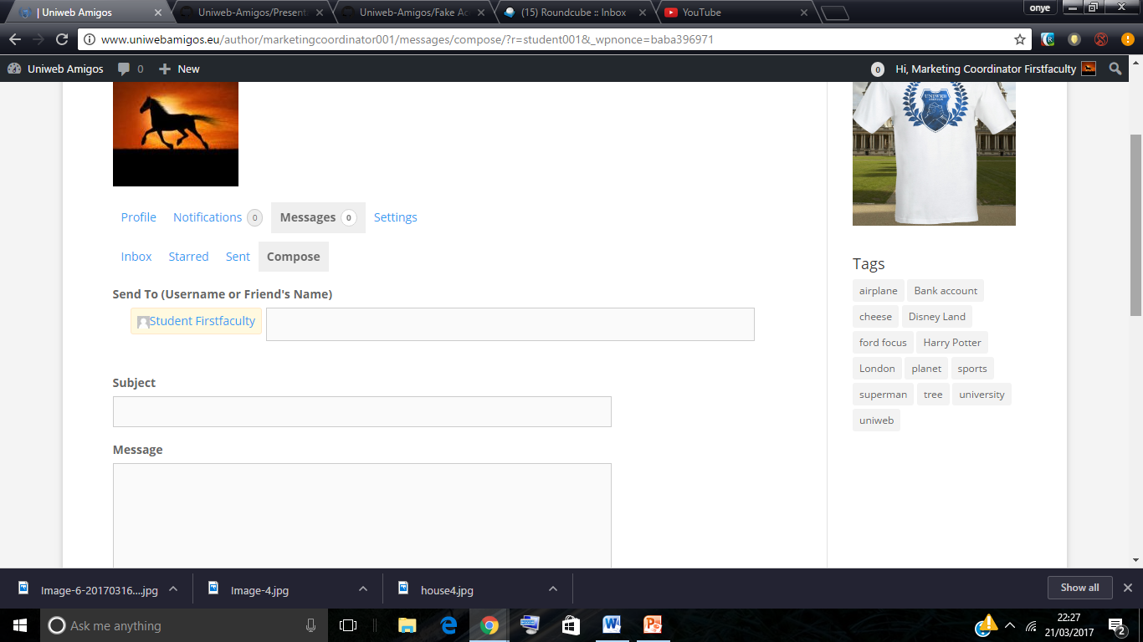
Also send messages to student. / compose message.. you can send two ways/ just like mailing system you can also check your inbox.

Slide 5
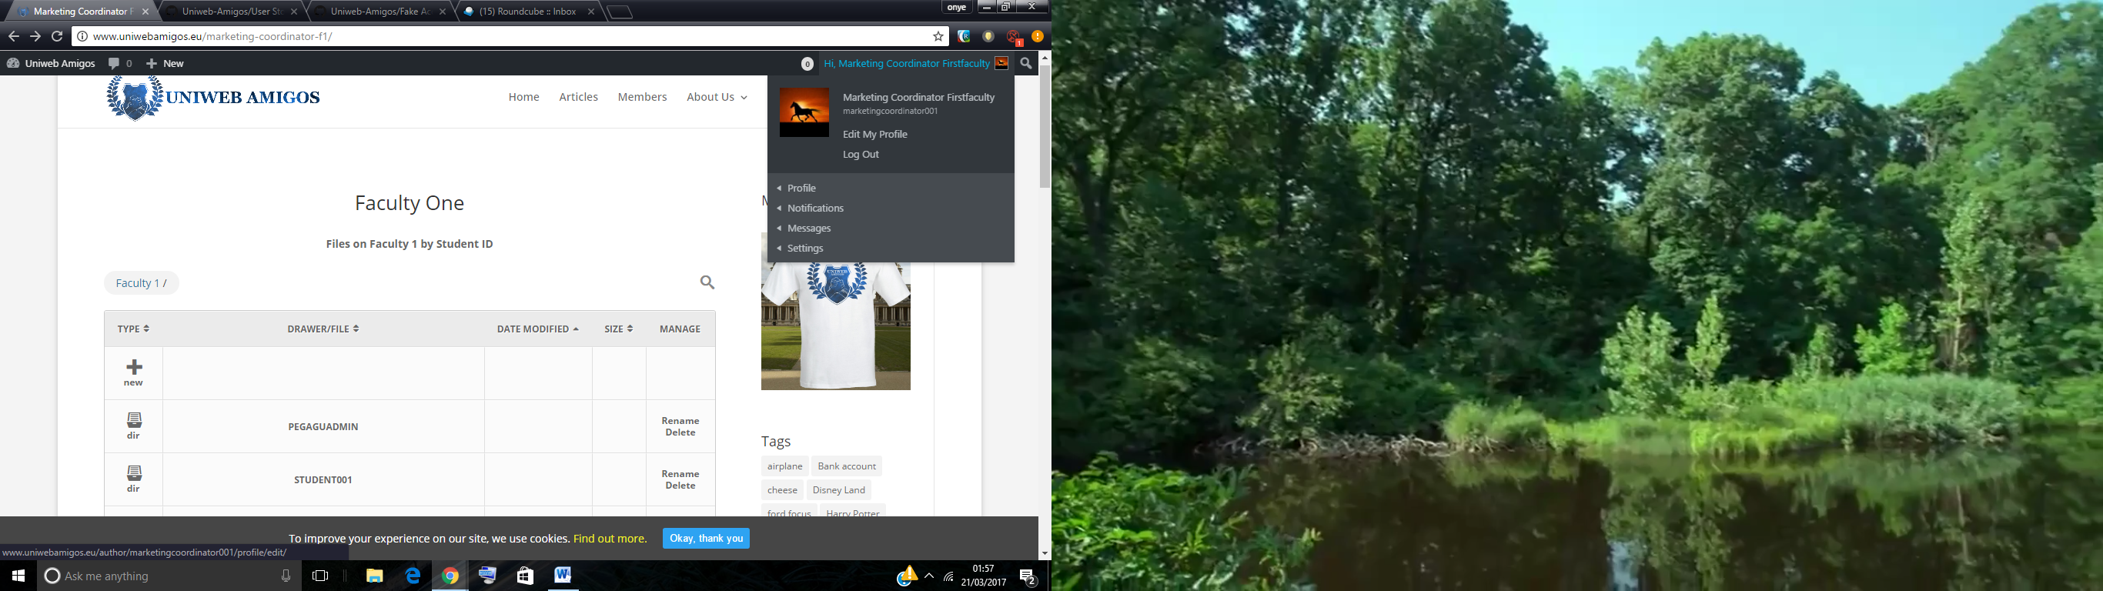
Accessing the dashboard and seeing all submissions within my faculty

Slide 6
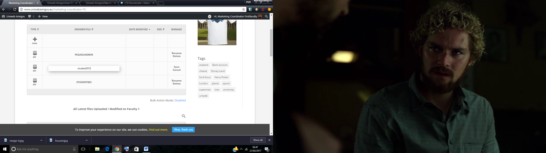
Marketing-coodinator can also rename, remove delete file can move them all delete all

Slide 7
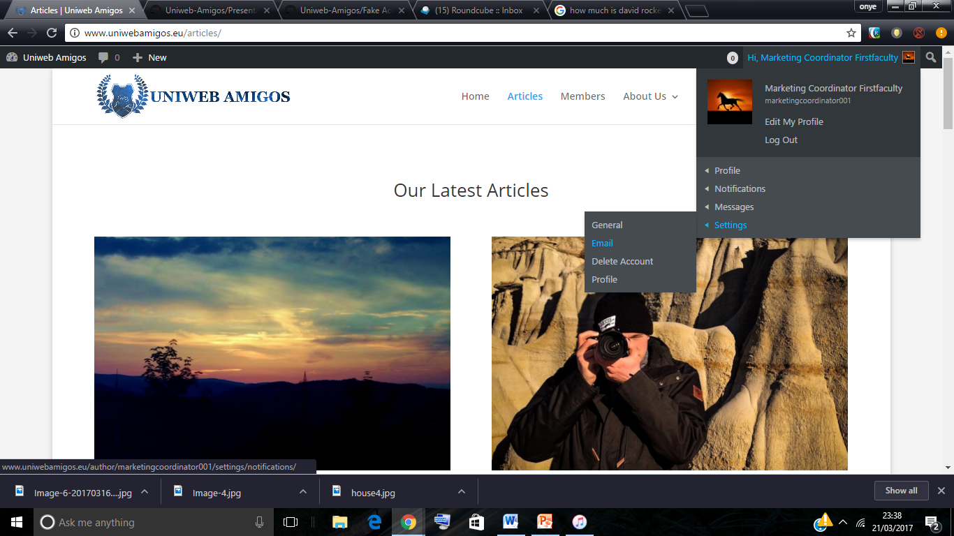
Different ways to access my dashboard and change my account setting

Slide 8
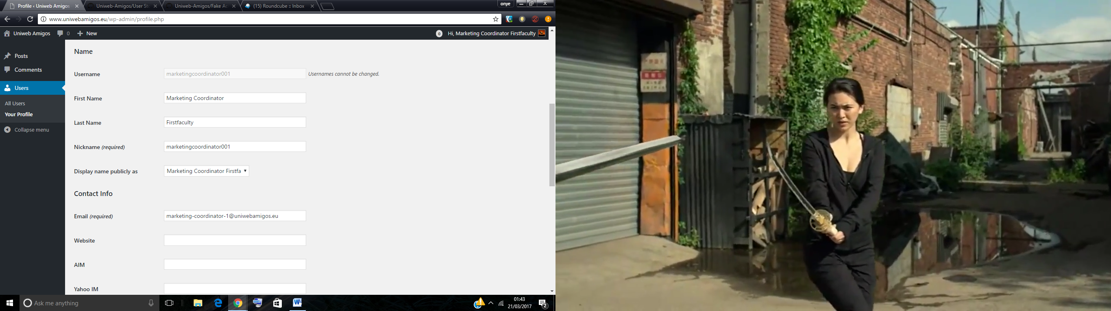
Can change my personal details and password

Slide 9
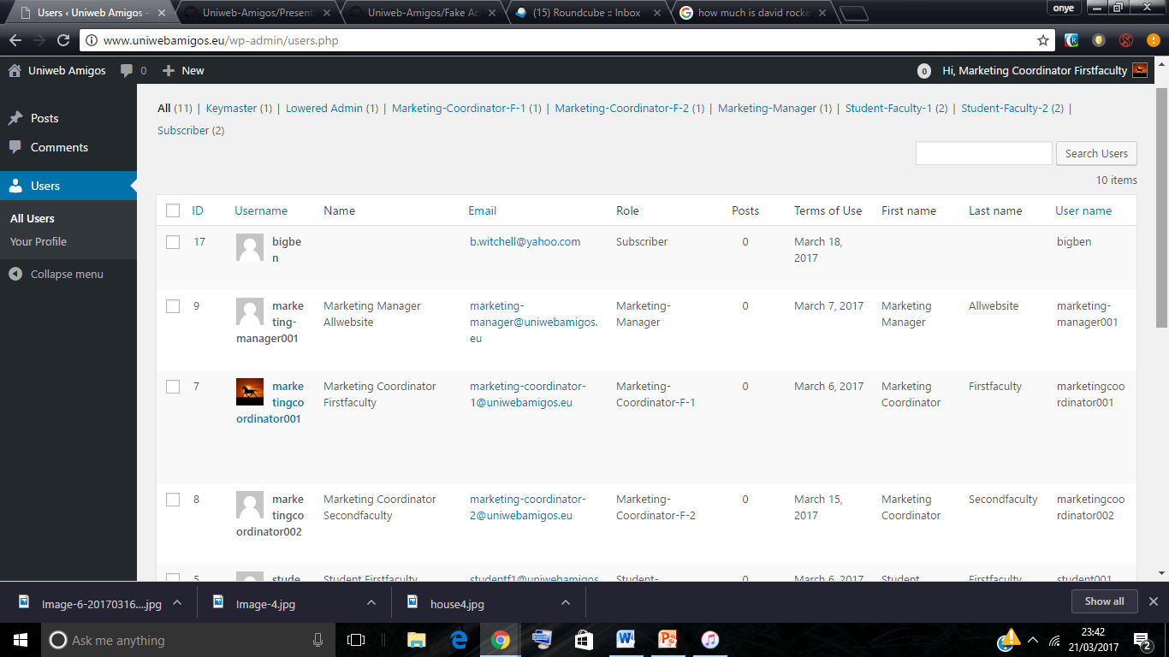
Can also view all the users and see how many times they posted

Slide 10
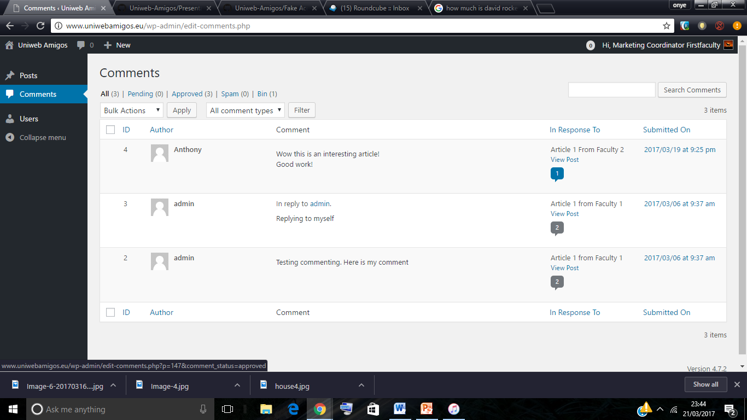
I can also view how many people comments, how ever I can only view not delete

Slide 11
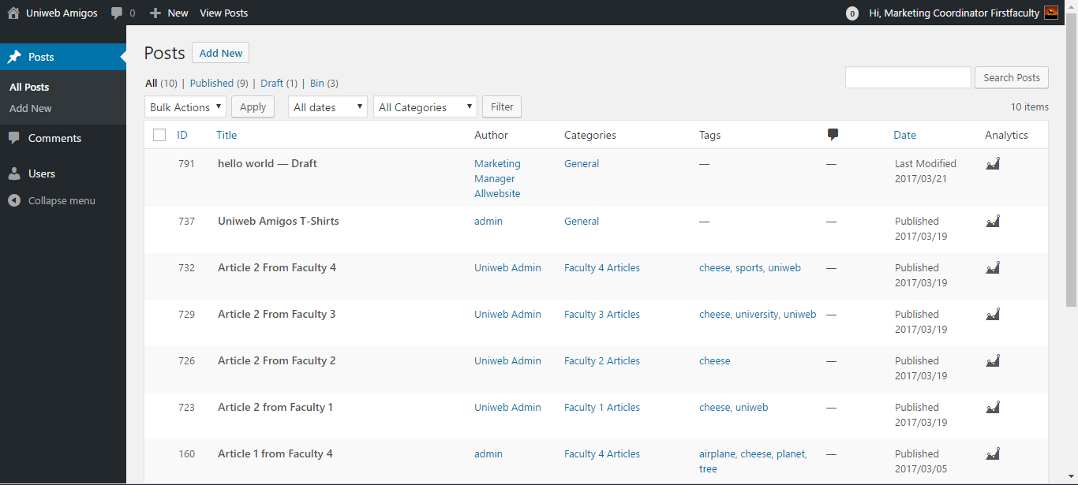
Can also view all the post and see how many people have viewed it.

Slide 12
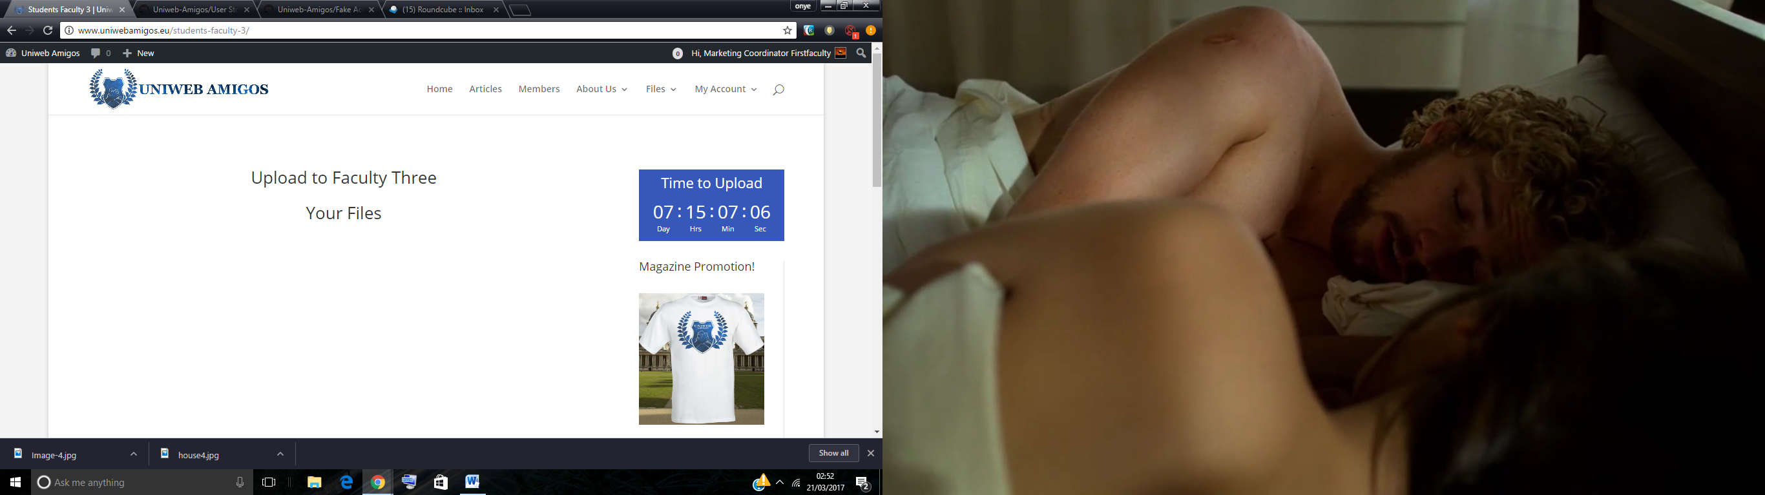
Timer for the student to remind them about the time left to upload

